Slide 1
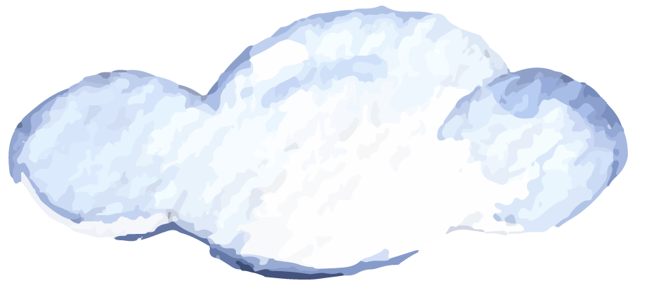
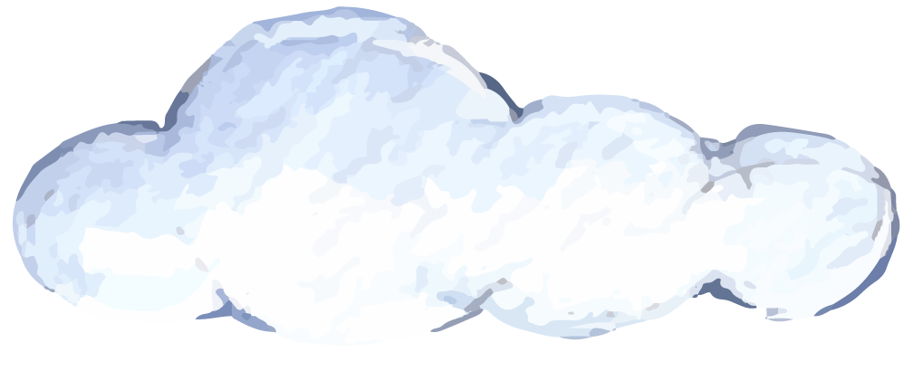
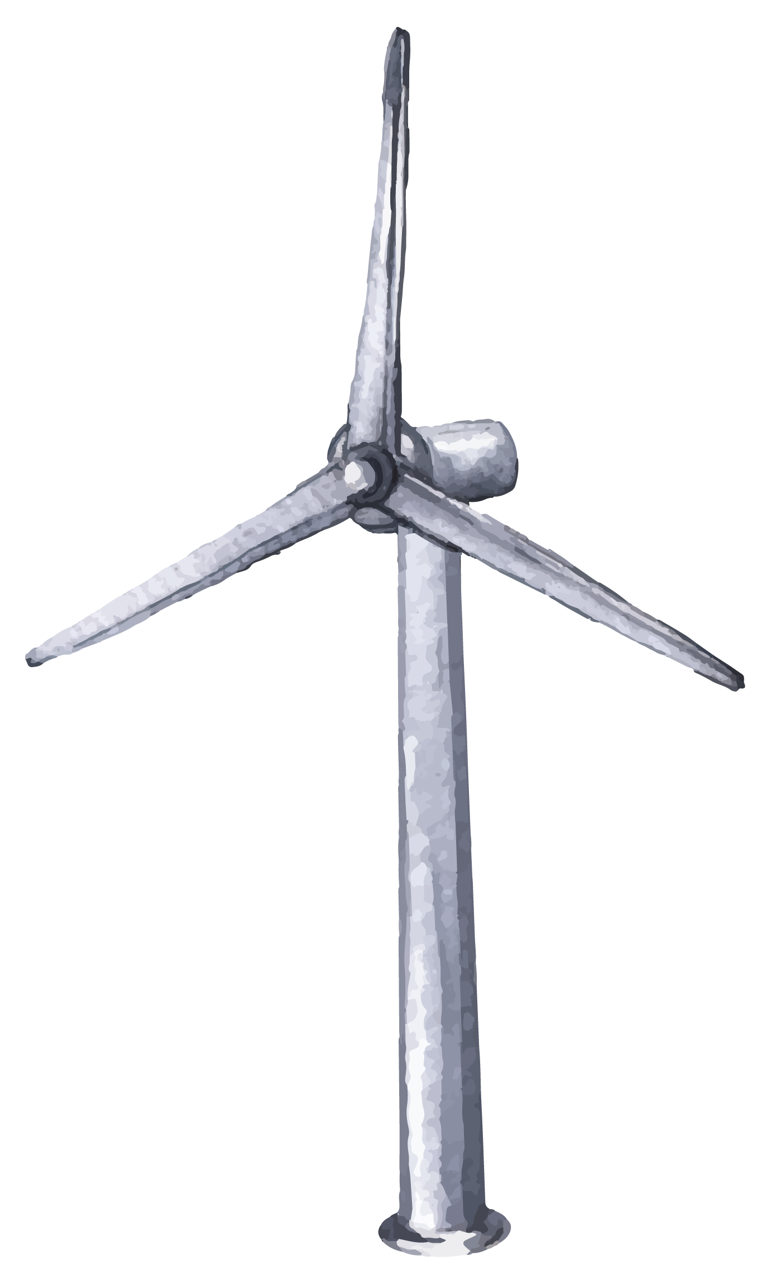
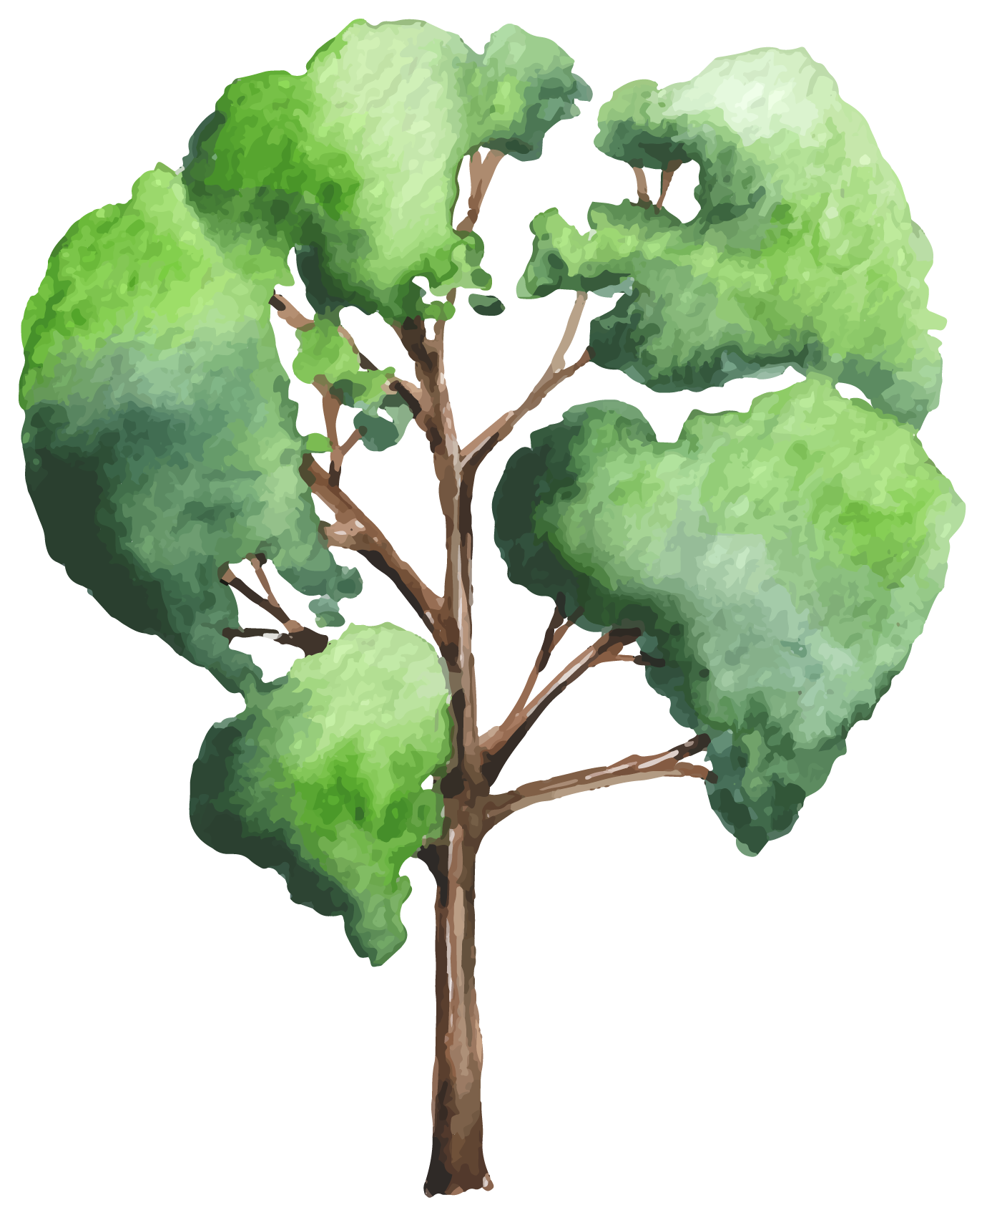
Wanderer
Embark on Eco-Friendly Adventures with

Slide 2
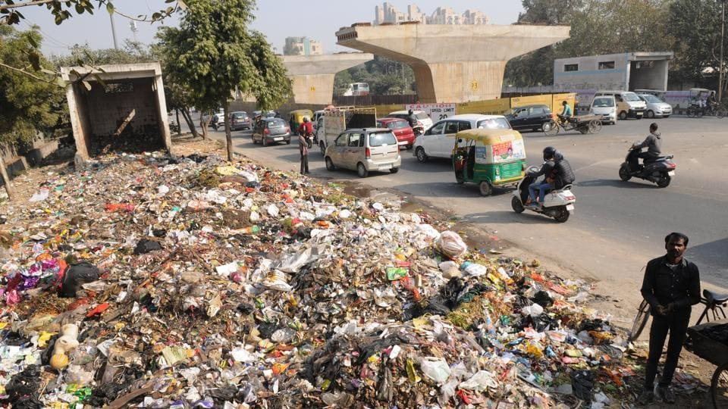
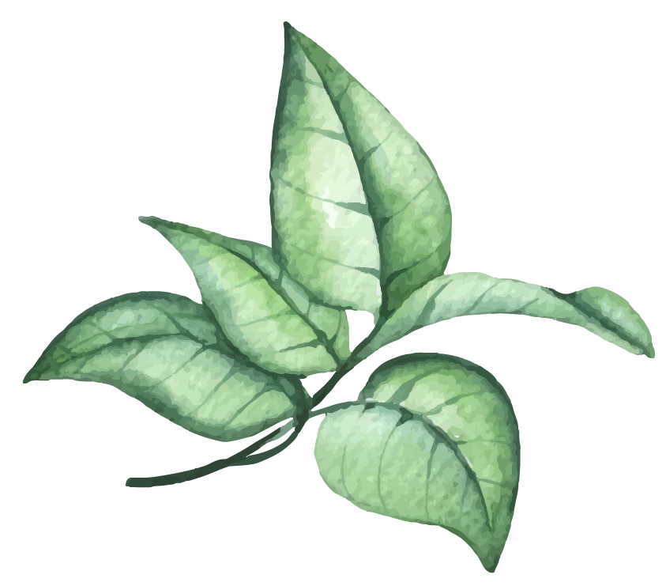
The Challenge
Increase in trash in public places
Effect on eco tourism
Impacts soil & wildlife

Slide 3

The Change
New era of recycling
Carbon-footprint reduction
Less effort, more cleaning

Slide 4
UML Diagram

Slide 5
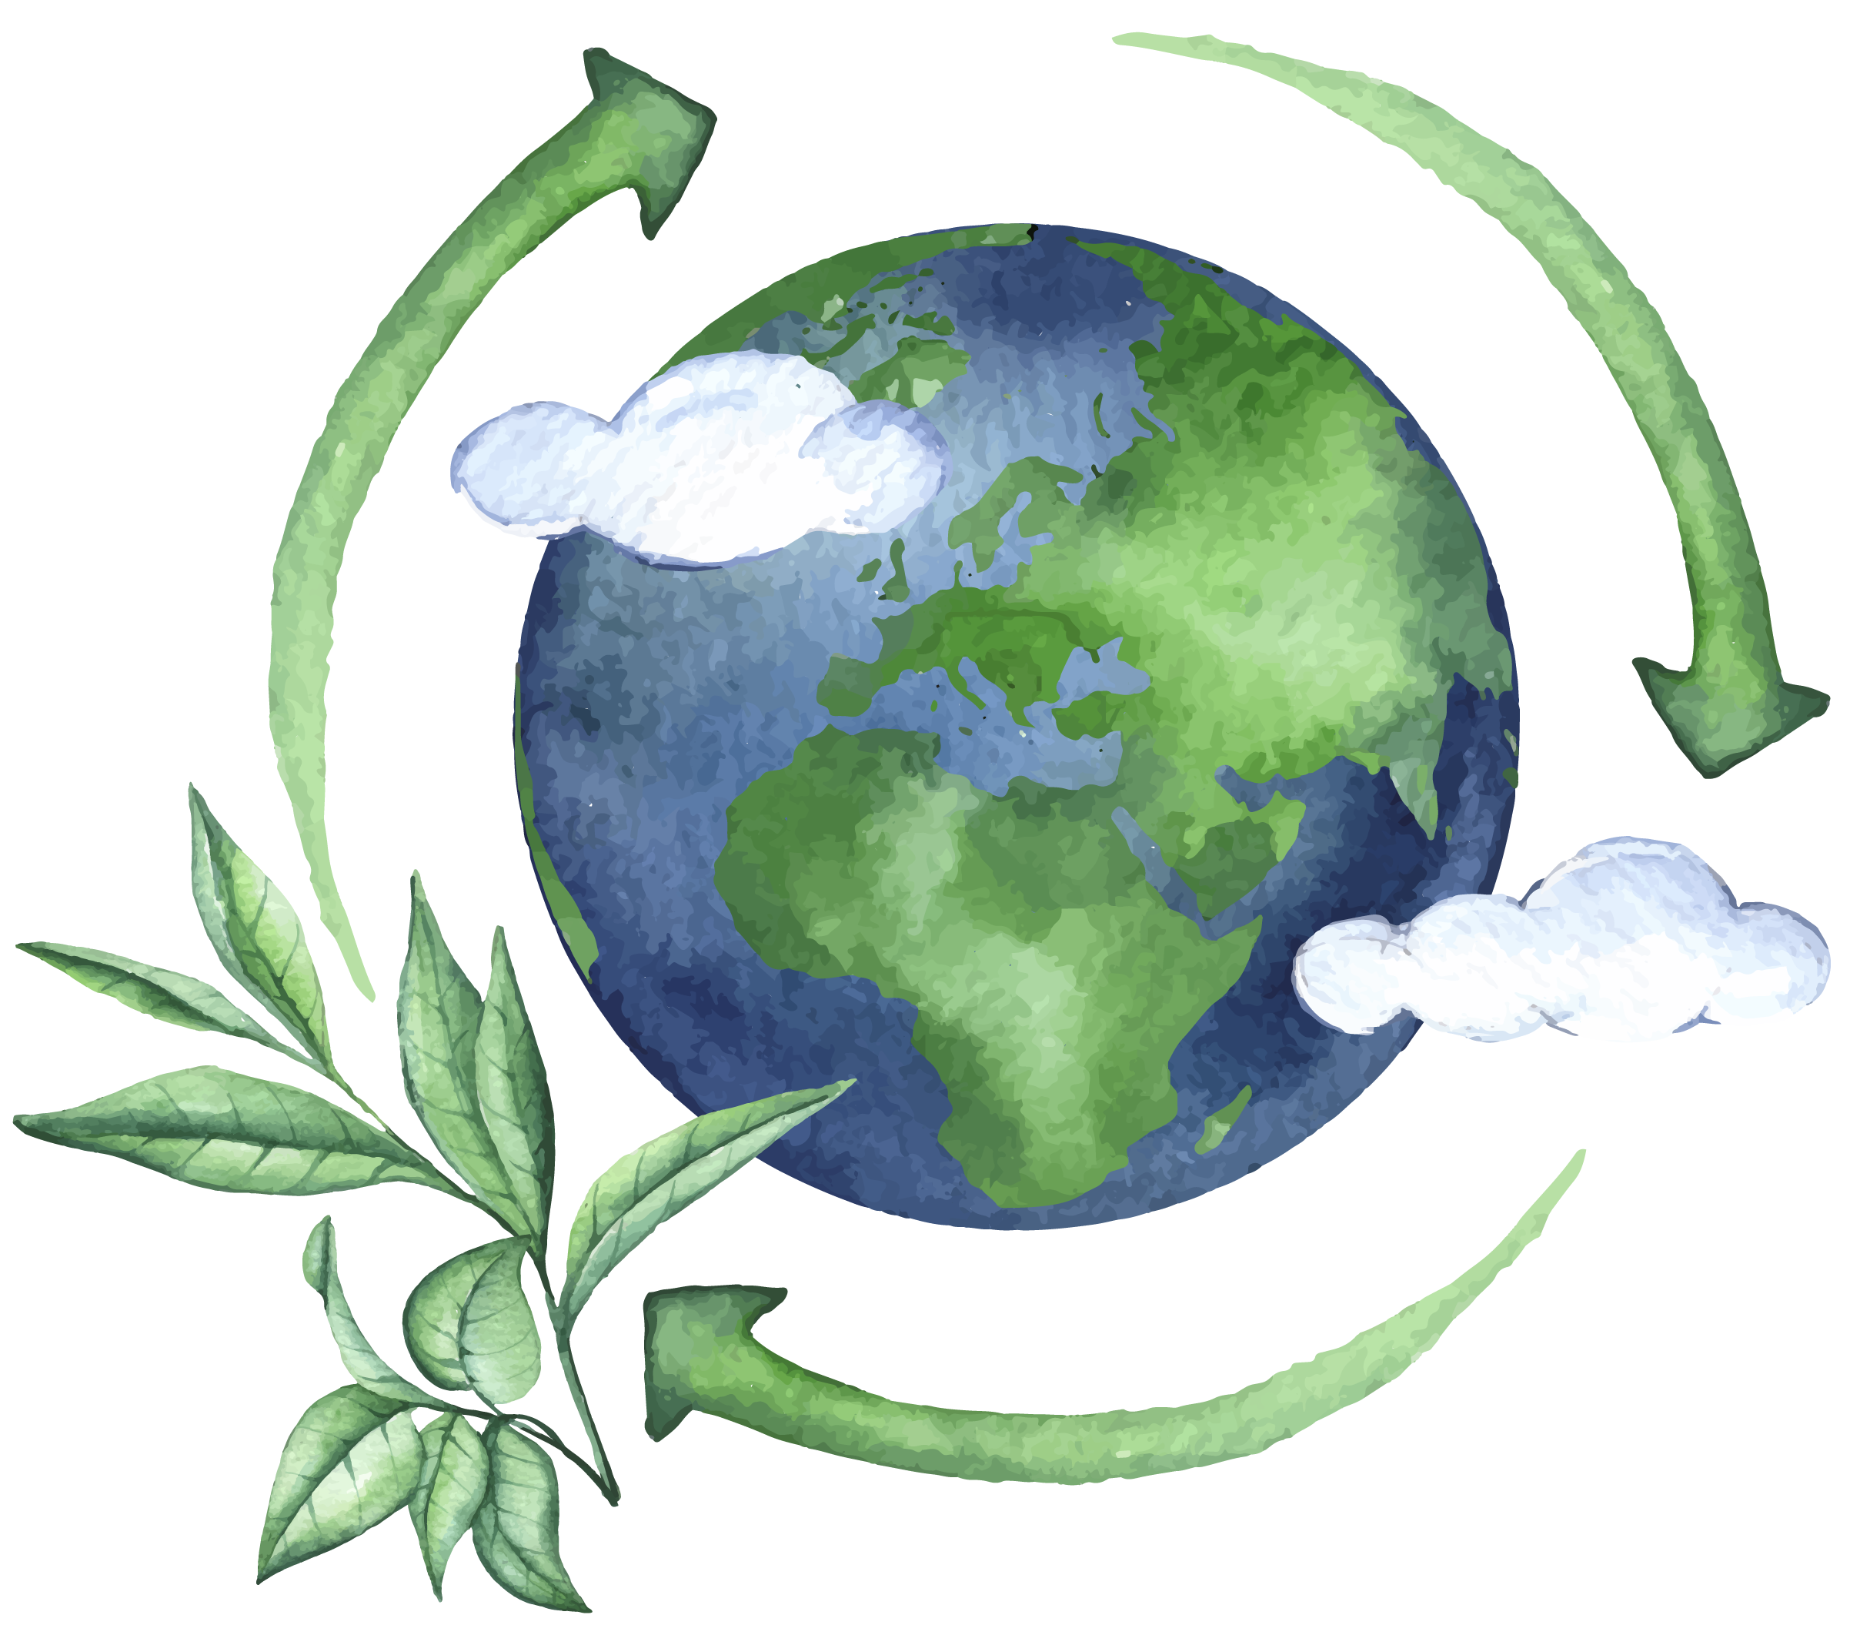

THANK YOU :)

